Slide 1
NEST: The Neural Simulation Tool
http://www.nest-simulator.org
NEST is a simulator for spiking neural network models focusing on the dynamics, size and structure of neural systems rather than on the exact morphology of individual neurons. NEST is ideal for networks of spiking neurons of any size, from individual neurons to whole-brain models.
Neuroinformatics tutorial
1.4 Simulation environments
Notes:
1

Slide 2
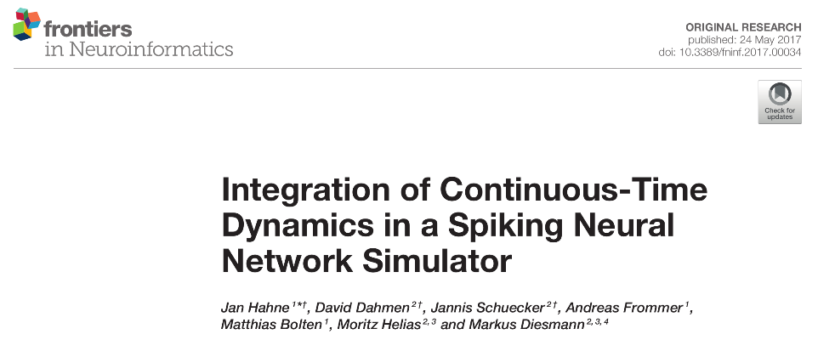
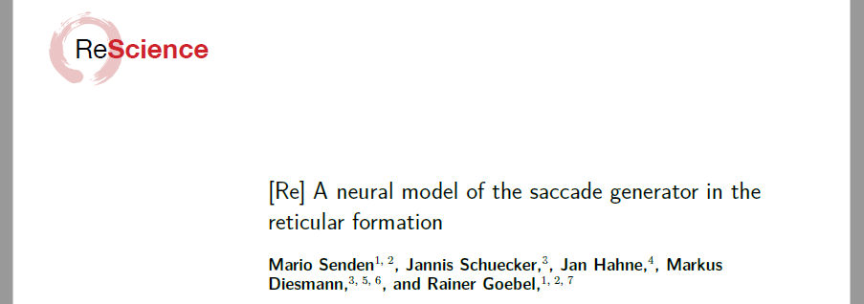

NEST: A powerful simulator
Focused on networks of spiking point neurons
Supports
Many neuron models including Hodgkin-Huxley-style, few-compartment models
binary and rate models
Synaptic plasticity including neuromodulatory signals
Structural plasticity
Gap junctions
Spatially structured networks
Python interface
Scales from laptops to supercomputers
Active user and developer community
Systematic quality control by continuous integration testing and code review
Based on over 20 years of experience
Notes:
2

Slide 3
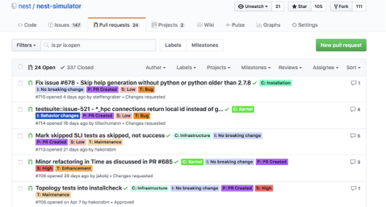
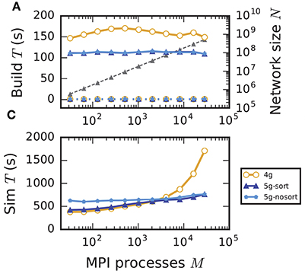
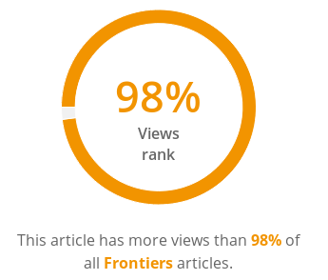
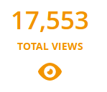
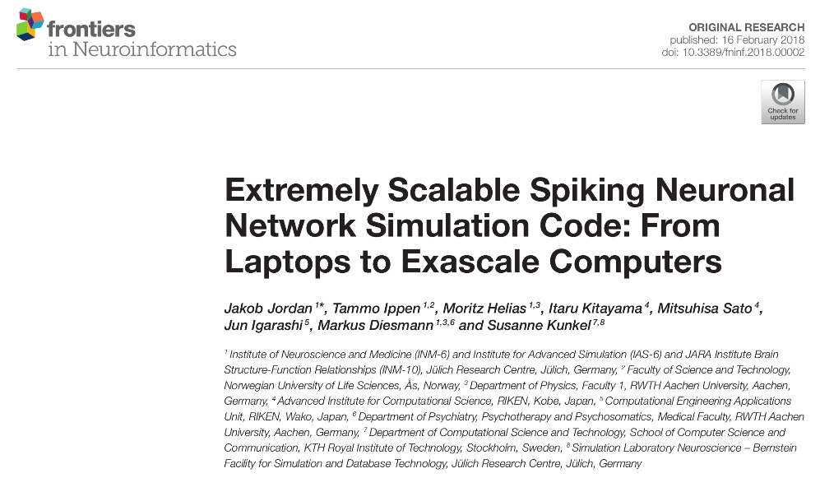
NEST Development
Active developer community on GitHub
Regular open developer video conferences
Focus on improving performance and usability
Some current projects
NESTML: Automatic code generation for neuron models
NESTIO: Efficient data recording to binary file formats
Dry-run mode: Efficient performance analysis on supercomputers
Exascale readiness
Optimized network construction speeds for highly parallel simulations of complex networks
Regular publications on NEST simulation technology
[2018-05-16]
shows how to make memory consumption of compute nodes independent of network size
Jordan et al. (2018)
Notes:
3

Slide 4
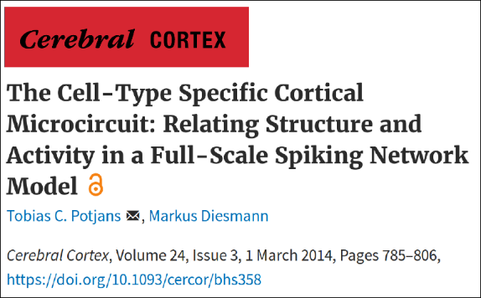
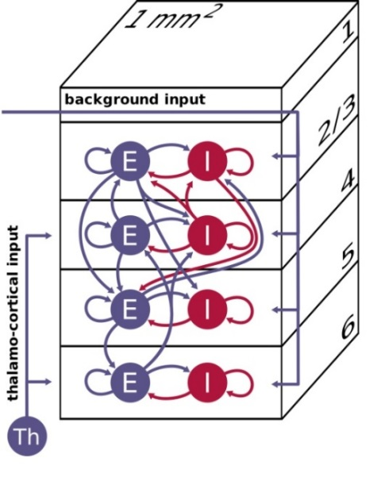
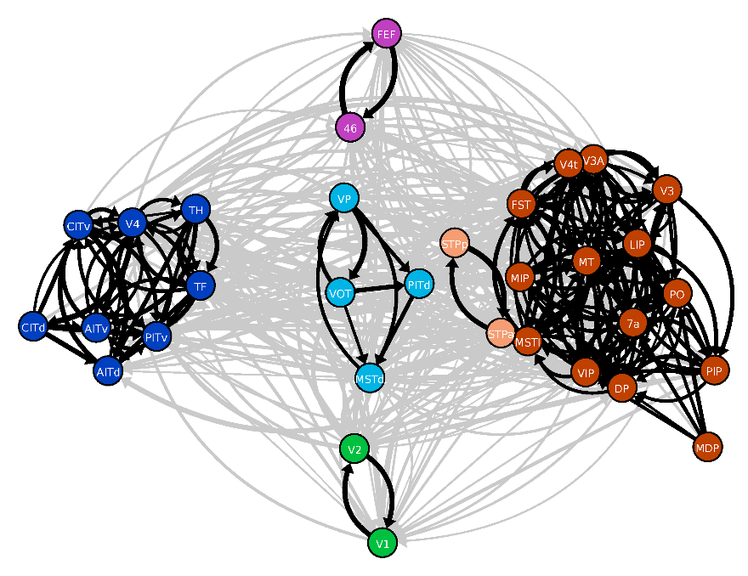
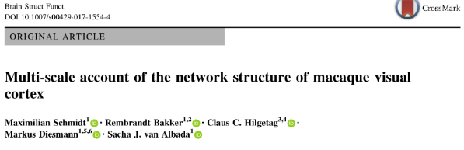
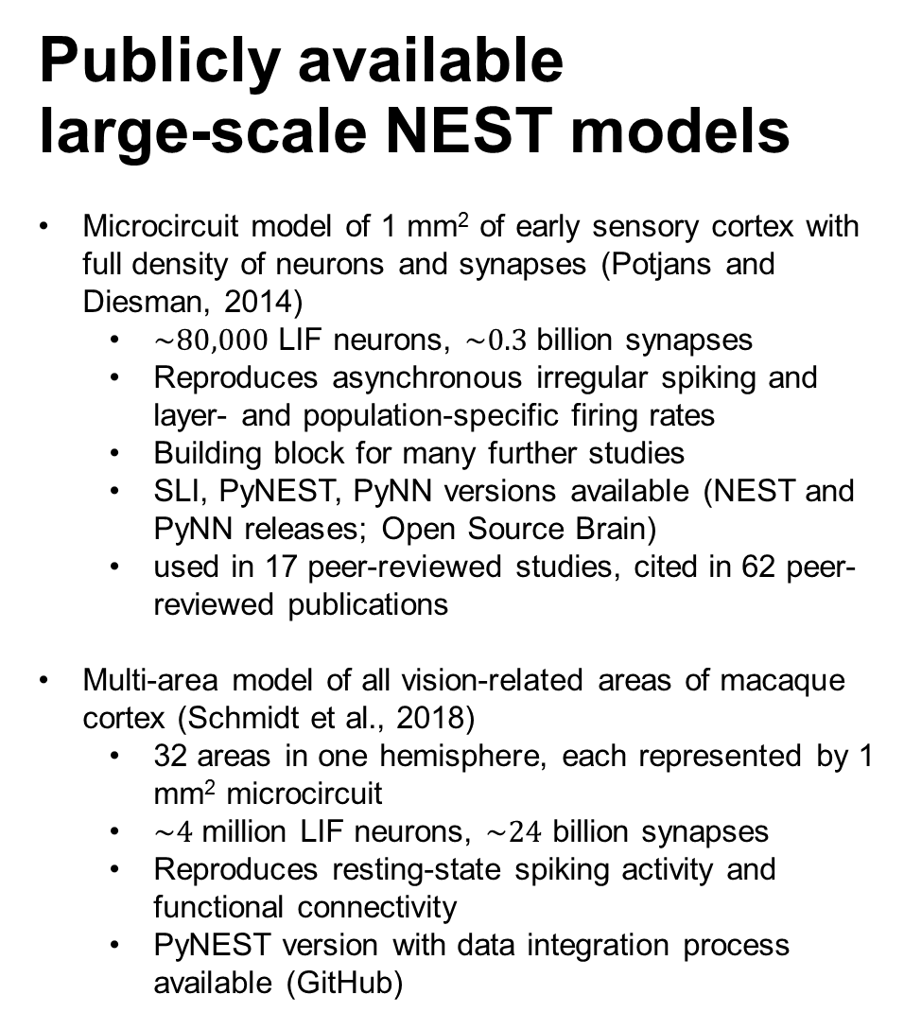
Publicly available
large-scale NEST models
Microcircuit model of 1 mm² of early sensory cortex with full density of neurons and synapses (Potjans and Diesman, 2014)
$\sim 80,000$ LIF neurons, $\sim 0.3$ billion synapses
Reproduces asynchronous irregular spiking and layer- and population-specific firing rates
Building block for many further studies
SLI, PyNEST, PyNN versions available (NEST and PyNN releases; Open Source Brain)
used in 17 peer-reviewed studies, cited in 62 peer-reviewed publications
Multi-area model of all vision-related areas of macaque cortex (Schmidt et al., 2018)
32 areas in one hemisphere, each represented by 1 mm² microcircuit
$\sim 4$ million LIF neurons, $\sim 24$ billion synapses
Reproduces resting-state spiking activity and functional connectivity
PyNEST version with data integration process available (GitHub)
Potjans and Diesmann (2014)
Schmidt et al. (2018)

Slide 5
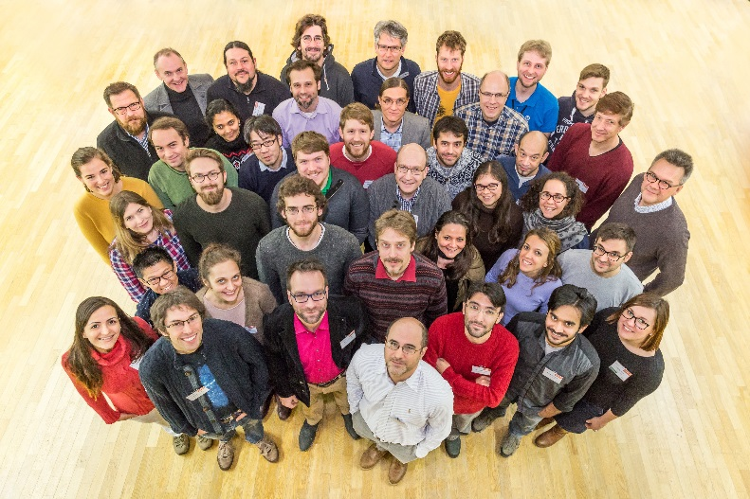


More NEST Resources
Simulator homepage
http://www.nest-simulator.org
Github repository
http://github.com/nest/nest-simulator
NEST User mailing list
http://mail.nest-initiative.org/cgi-bin/mailman/listinfo/nest_user
NEST Initiative
http://www.nest-initiative.org
Annual NEST Conference
Notes:
5

